Slide 1
Bell ringer
CODE: GREEN
What transformations from the original function f(x) are included in the function notation below?
$$g\left(x\right)=−2f\left(x+3\right)−4$$

Slide 2
POLYNOMIALS
QUADRATIC & CUBIC FUNCTIONS

Slide 3
Quadratic & cubic
CODE: BLUE
The same way a quadratic function can be written in the form…
$$ax^{2}+bx+c$$
…a cubic function can be written in the form...
$$ax^{3}+bx^{2}+cx+d$$

Slide 4
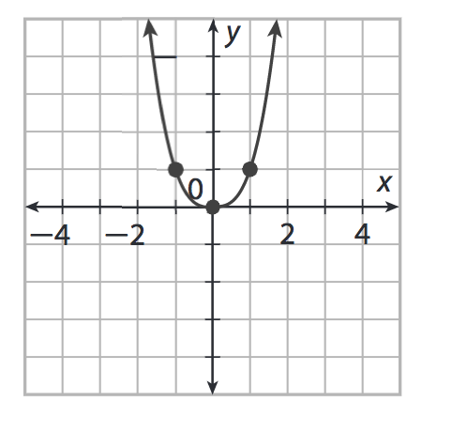
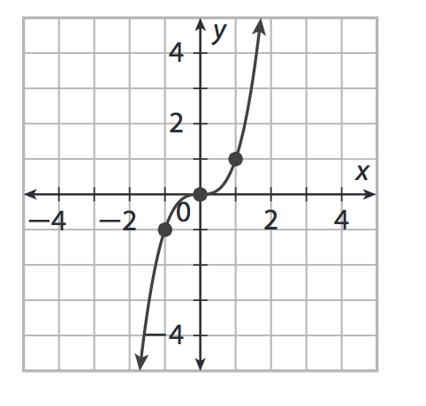
Quadratic & cubic
CODE: BLUE
Both types of functions can be graphed using their parent functions and any necessary transformations.
Quadratic Parent Function
$f(x)=x^{2}$
Cubic Parent Function
$f(x)=x^{3}$

Slide 5
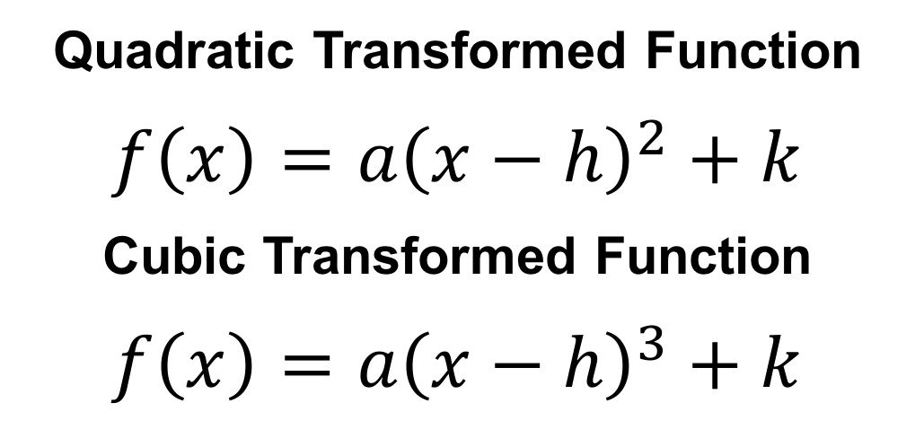
Quadratic & cubic
CODE: BLUE
Both types of functions can be graphed using their parent functions and any necessary transformations.
Quadratic Transformed Function
$f\left(x\right)={a\left(x−h\right)}^{2}+k$
Cubic Transformed Function
$f\left(x\right)={a\left(x−h\right)}^{3}+k$

Slide 6
QUADRATIC & CUBIC
CODE: BLUE
Sketch a graph of the function
$$f\left(x\right)=2{\left(x−3\right)}^{3}+1$$

Slide 7
QUADRATIC & CUBIC
CODE: BLUE
Sketch a graph of the function
$$f\left(x\right)=\frac{1}{3}{\left(x+2\right)}^{2}−5$$

Slide 8
QUADRATIC & CUBIC
CODE: YELLOW
Sketch a graph of the function
$$f\left(x\right)=3{\left(x+4\right)}^{3}$$

Slide 9
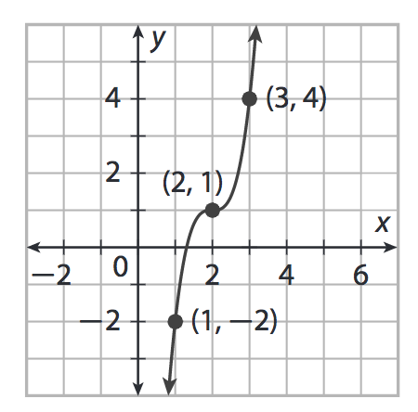
QUADRATIC & CUBIC
CODE: BLUE
Write the equation of the function graphed below using transformations.

Slide 10
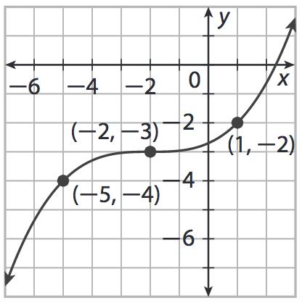
QUADRATIC & CUBIC
CODE: YELLOW
Write the equation of the function graphed below using transformations.

Slide 11
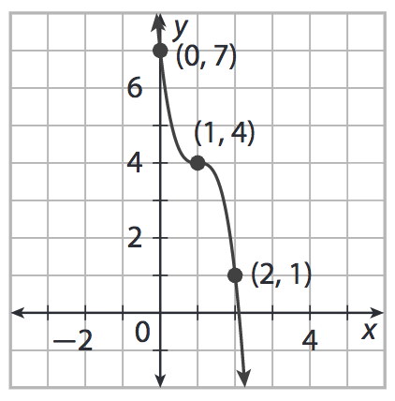
EXIT TICKET
CODE: RED
State the transformations from the parent function $f(x)=x^{3}$ in the graph below. Then write an equation for the function.

