Slide 1
Bell ringer
CODE: GREEN
What is a transformation?
Give three examples of different types of transformations. [verbal or visual]

Slide 2

FUNCTIONS
TRANSFORMATIONS

Slide 3
transformations
CODE: BLUE
A transformation is any change to a function’s graph.
A graph can be translated, reflected, or stretched using function notation.

Slide 4
transformations
CODE: YELLOW
Explore 1
Fill in the table and graph the transformed figure.

Slide 5
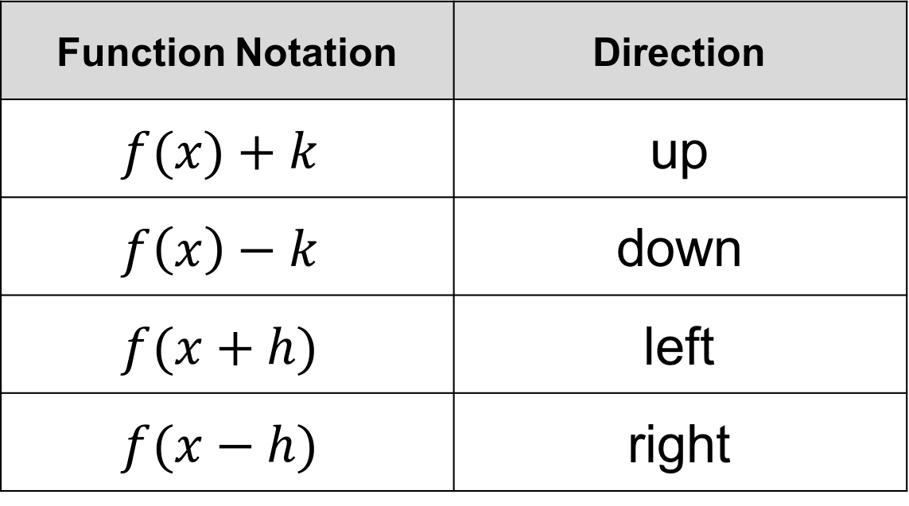
TRANSFORMATIONS
CODE: BLUE
Translations
Function Notation | Direction
$$f(x)+k$$ | up
$$f\left(x\right)−k$$ | down
$$f(x+h)$$ | left
$$f(x−h)$$ | right

Slide 6
transformations
CODE: YELLOW
Explore 2
Fill in the table and graph the transformed figure.

Slide 7
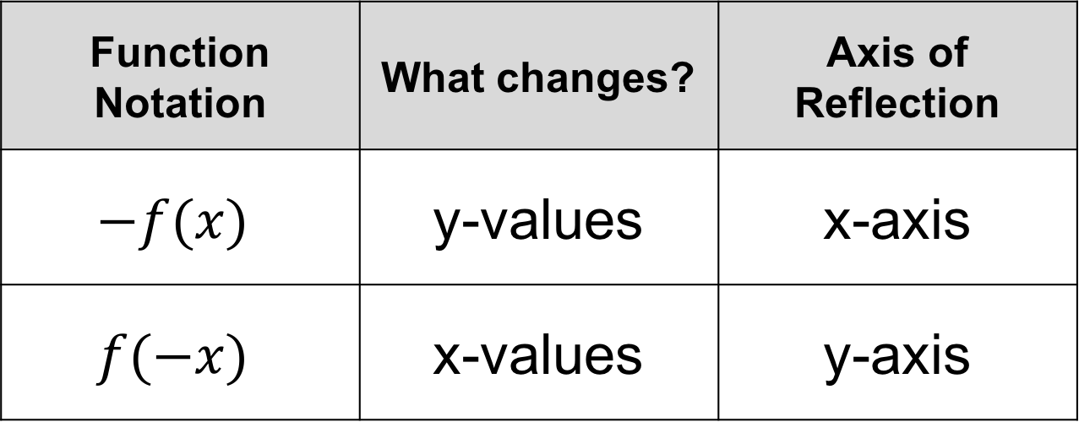
TRANSFORMATIONS
CODE: BLUE
Reflections
Function Notation | What changes? | Axis of Reflection
$$−f(x)$$ | y-values | x-axis
$$f(−x)$$ | x-values | y-axis

Slide 8
transformations
CODE: YELLOW
Explore 3
Fill in the table and graph the transformed figure.

Slide 9
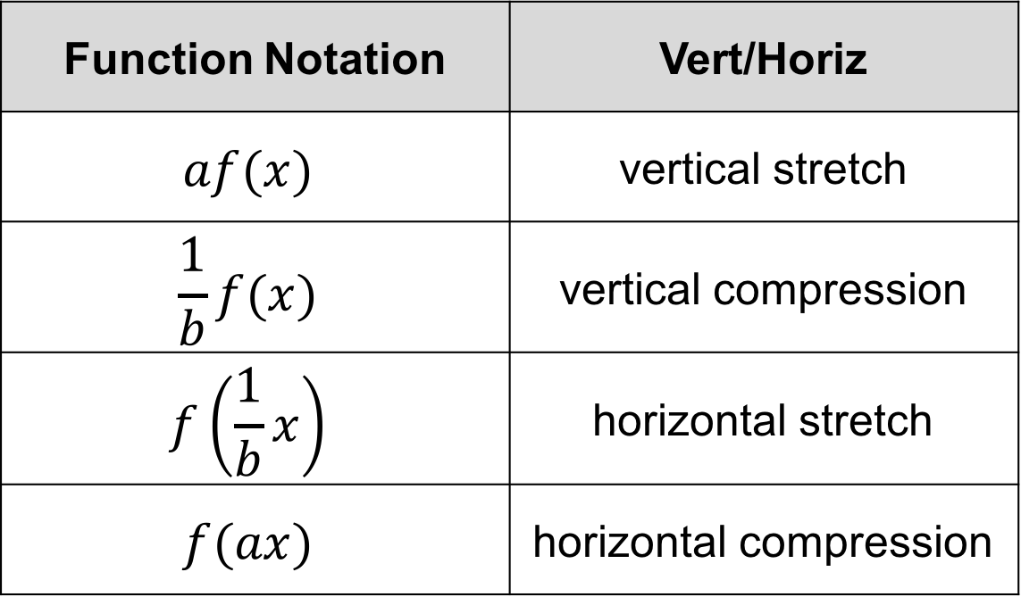
TRANSFORMATIONS
CODE: BLUE
Stretch/Compression
Function Notation | Vert/Horiz
$$af(x)$$ | vertical stretch
$$\frac{1}{b}f(x)$$ | vertical compression
$$f\left(\frac{1}{b}x\right)$$ | horizontal stretch
$$f(ax)$$ | horizontal compression

Slide 10
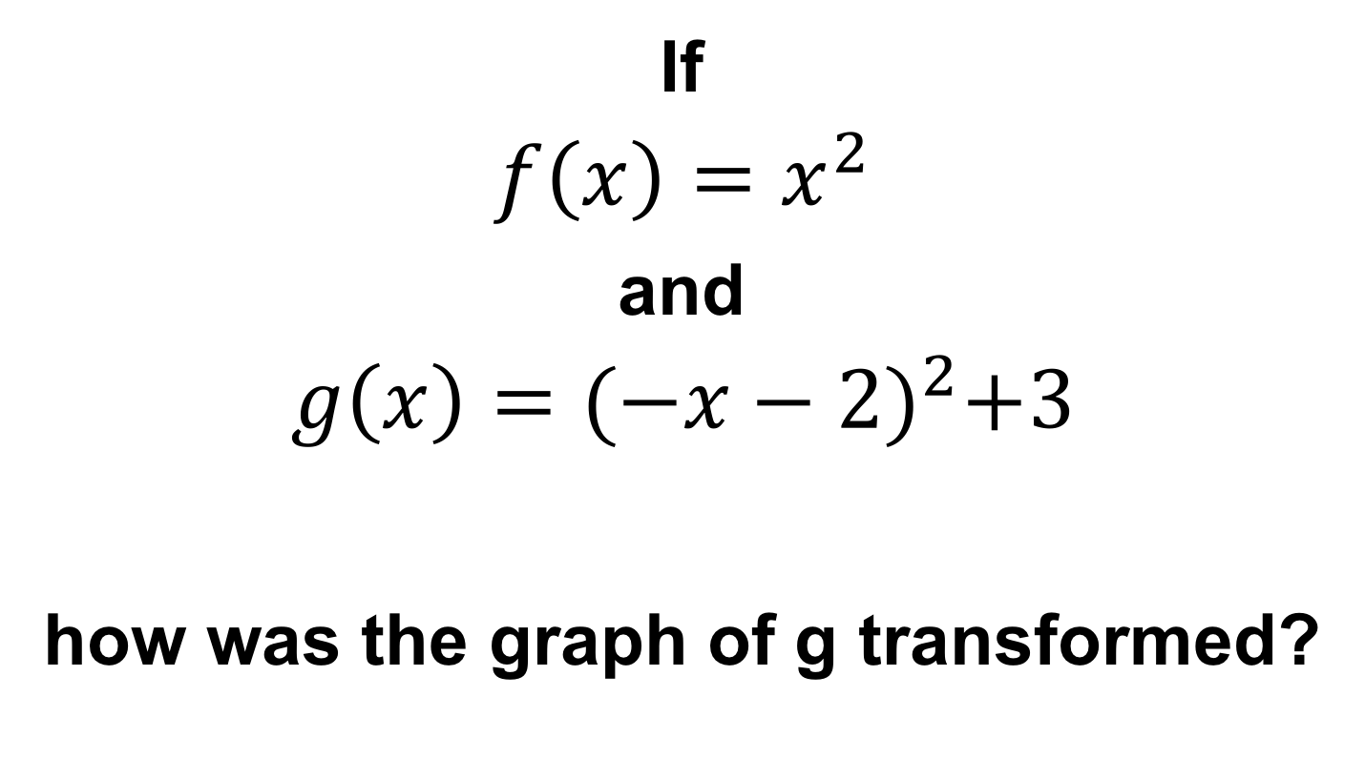
transformations
CODE: BLUE
If
$$f\left(x\right)=x^{2}$$
and
$$g\left(x\right)={(−x−2)}^{2}+3$$
how was the graph of g transformed?

Slide 11
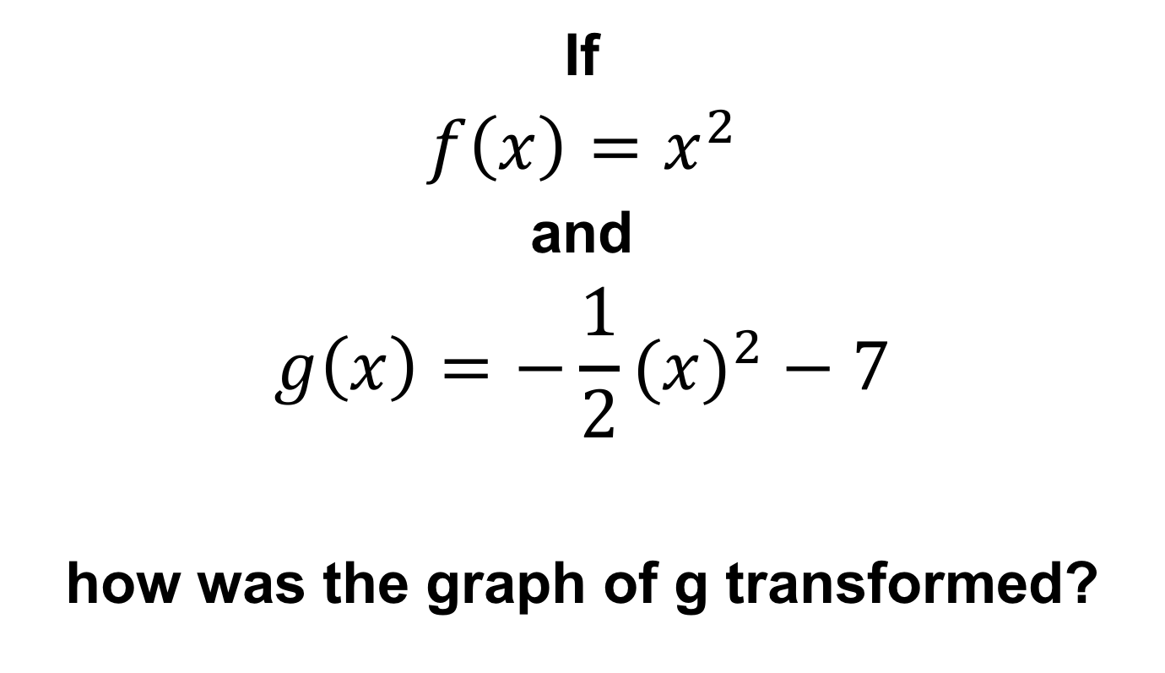
transformations
CODE: YELLOW
If
$$f\left(x\right)=x^{2}$$
and
$$g\left(x\right)={−\frac{1}{2}(x)}^{2}−7$$
how was the graph of g transformed?

Slide 12
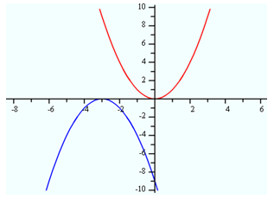
transformations
CODE: BLUE
Describe the transformations that occurred on this graph in words and function notation.

Slide 13
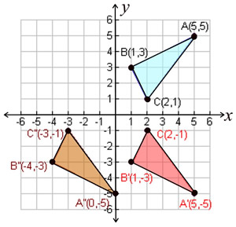
transformations
CODE: YELLOW
Describe the transformations that occurred on this graph in words and function notation.

Slide 14

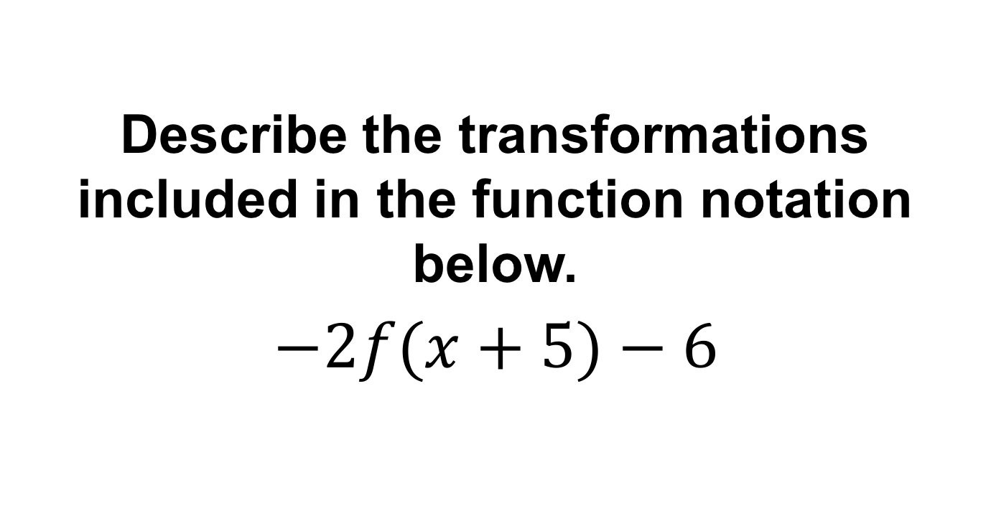
EXIT TICKET
CODE: RED
Describe the transformations included in the function notation below.
$$−2f(x+5)−6$$

