Slide 1
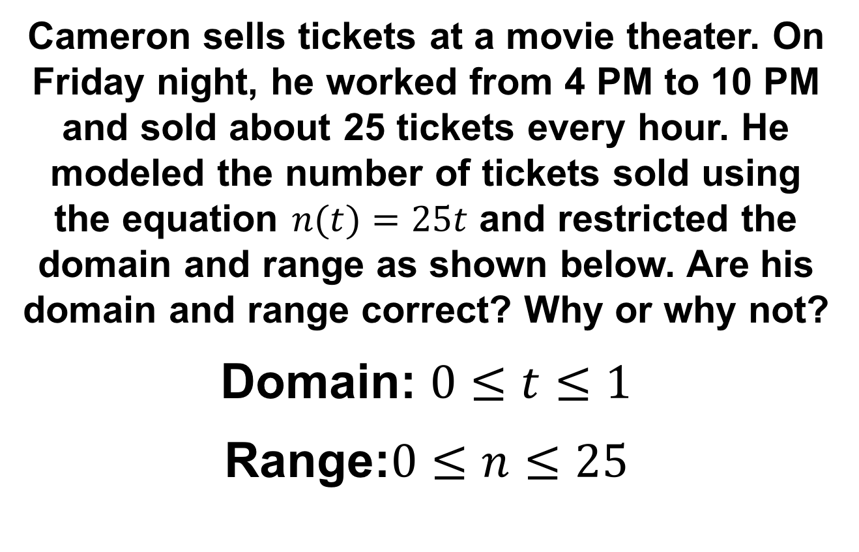
Bell ringer
CODE: GREEN
Cameron sells tickets at a movie theater. On Friday night, he worked from 4 PM to 10 PM and sold about 25 tickets every hour. He modeled the number of tickets sold using the equation $n(t)=25t$ and restricted the domain and range as shown below. Are his domain and range correct? Why or why not?
Domain: $0≤t≤1$
Range:$0≤n≤25$

Slide 2

FUNCTIONS
BEHAVIOR & EXTREMA

Slide 3
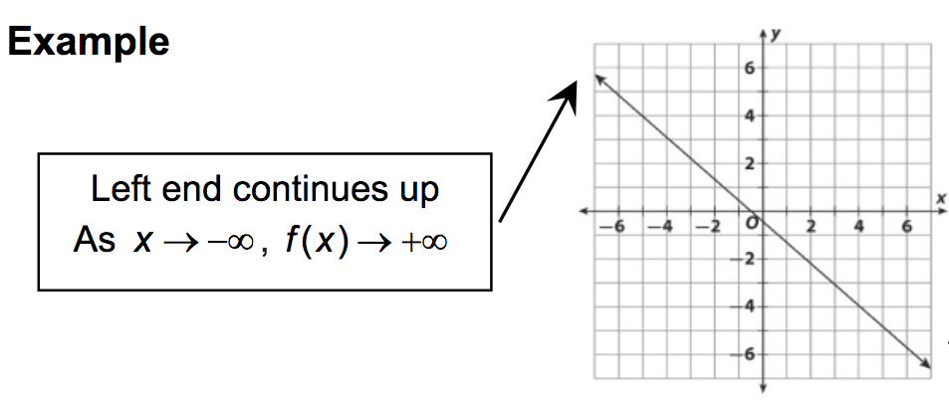
END BEHAVIOR
CODE: BLUE
The end behavior of a function describes what happens beyond the graph.

Slide 4
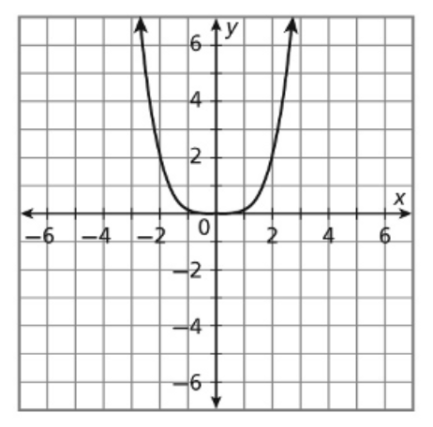
END BEHAVIOR
CODE: YELLOW
The end behavior of a function describes what happens beyond the graph.

Slide 5
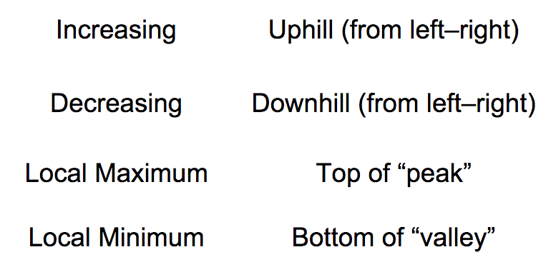
Behavior & extrema
CODE: BLUE
Behavior describes the direction of a function’s graph, and extrema are the extreme values of a function.

Slide 6
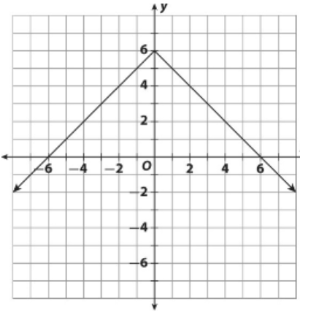
Behavior & extrema
CODE: BLUE
Behavior describes the direction of a function’s graph, and extrema are the extreme values of a function.

Slide 7
Behavior & extrema
CODE: YELLOW
Describe the end behavior of the graph below. Then described its behavior and find any local extrema.

