Slide 1
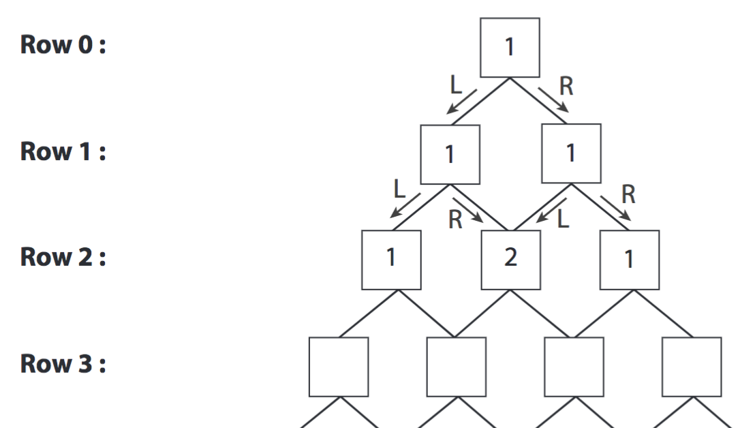
Bell ringer
CODE: GREEN
Copy rows 0-2 and complete rows 3-6 of Pascal’s Triangle.
…

Slide 2
POLYNOMIALS
BINOMIAL THEOREM

Slide 3
BINOMIAL THEOREM
CODE: BLUE
Binomial Theorem is a simpler way to expand/multiply binomials.
It is related to Pascal’s triangle and a pattern within the exponents of an expanded polynomial.

Slide 4
BINOMIAL THEOREM
CODE: YELLOW
Multiplying Polynomials
In your group, multiply your given polynomials.

Slide 5
BINOMIAL THEOREM
CODE: BLUE
Multiplying Polynomials
$${\left(a+b\right)}^{0}=$$
$${\left(a+b\right)}^{1}=$$
$${\left(a+b\right)}^{2}=$$
$${\left(a+b\right)}^{3}=$$
${\left(a+b\right)}^{4}=$ ?

Slide 6
BINOMIAL THEOREM
CODE: BLUE
The Binomial Theorem states that to expand a binomial, the coefficients come from Pascal’s Triangle and the exponents go in descending order for the first term and ascending order for the second term.
$${\left(a+b\right)}^{4}=$$
$$1a^{4}b^{0}+4a^{3}b^{1}+6a^{2}b^{2}+4a^{1}b^{3}+1a^{0}b^{4}$$

Slide 7
BINOMIAL THEOREM
CODE: BLUE
Expand the binomial below.
(2x – 4)³

Slide 8
BINOMIAL THEOREM
CODE: YELLOW
Expand the binomial below.
(x² + 2)⁵

Slide 9
BINOMIAL THEOREM
CODE: BLUE
Find the third term of the expanded polynomial.
(3x – 2)⁶

Slide 10
BINOMIAL THEOREM
CODE: YELLOW
Find the second term of the expanded polynomial.
(4x – 2)⁵

Slide 11
EXIT TICKET
CODE: RED
Find the fourth term of the expanded binomial.
$$f\left(x\right)={\left(3+2x^{3}\right)}^{6}$$

