Slide 1
Bell ringer
CODE: GREEN
Sketch a graph of each.
y = 2x + 5
y = -½x – 3
y = -4

Slide 2
POLYNOMIALS & RATIONAL FUNCTIONS
GRAPHING QUADRATIC FUNCTIONS

Slide 3
QUADRATICS
CODE: BLUE
The standard form of a quadratic function is written as…
$$f(x)=a{\left(x−h\right)}^{2}+k$$
… where a≠0.
The vertex of the parabola is at (h,k) and the parabola is symmetric with respect to the line x = h.

Slide 4
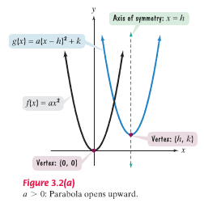
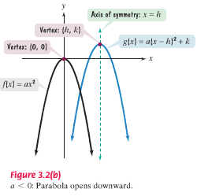
QUADRATICS
CODE: BLUE

Slide 5
QUADRATICS
CODE: BLUE
A quadratic function can also be written as…
$$f(x)=ax^{2}+bx+c$$
… where a≠0.
The vertex of the parabola is at $(−\frac{b}{2a},f(−\frac{b}{2a}))$ and the parabola is symmetric with respect to the line x = h.

Slide 6
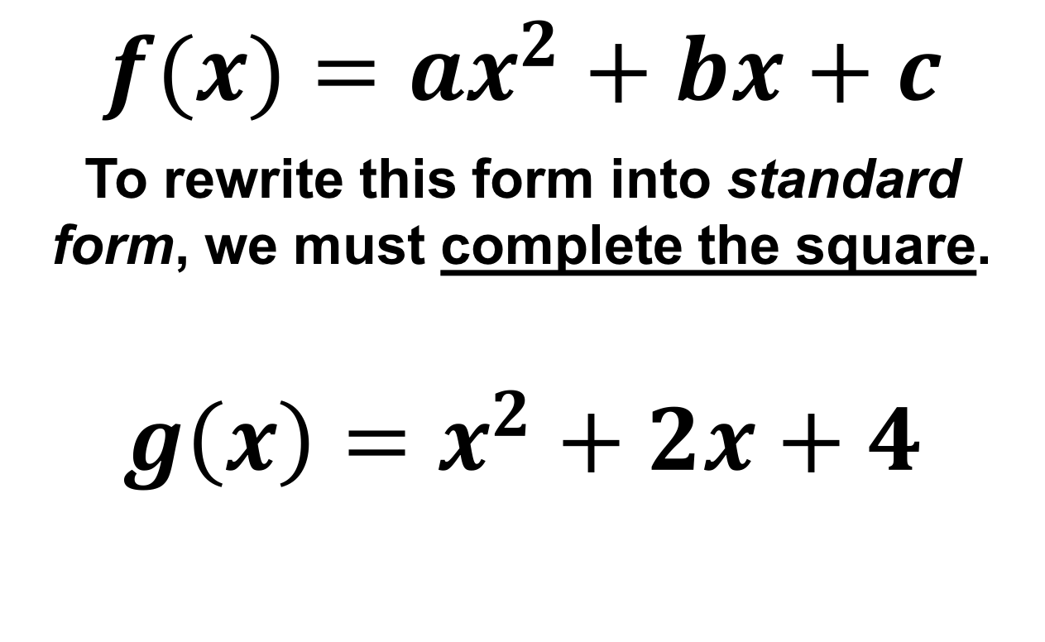
QUADRATICS
CODE: BLUE
$$f(x)=ax^{2}+bx+c$$
To rewrite this form into standard form, we must complete the square.
$${g\left(x\right)=x}^{2}+2x+4$$

Slide 7
QUADRATICS
CODE: YELLOW
Rewrite the following equation in standard form.
$${g\left(x\right)=x}^{2}+6x−5$$

Slide 8
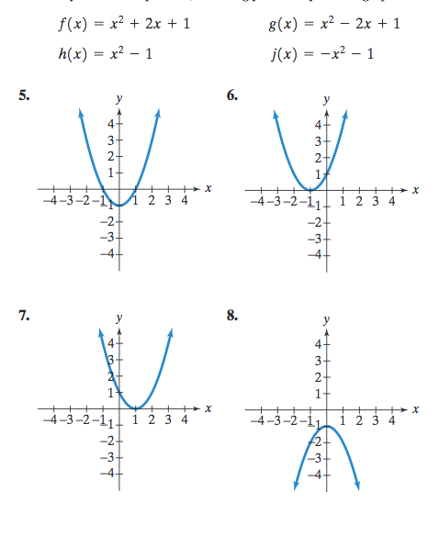
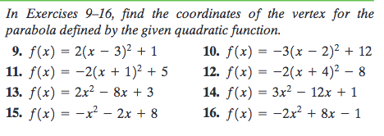
QUADRATICS
CODE: GREEN

