Slide 1
Bell ringer
CODE: GREEN
Solve the quadratic equation below by completing the square.
$$x^{2}+8x+14=0$$

Slide 2
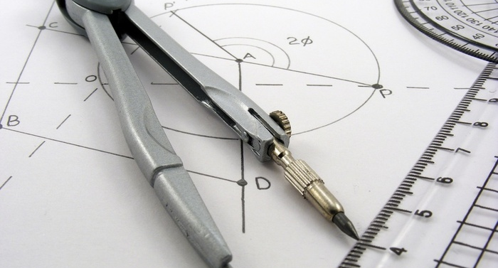
QUADRATIC FUNCTIONS
QUADRATIC FORMULA

Slide 3
QUADRATIC FORMULA
CODE: BLUE
The quadratic formula can be used to solve quadratic equations in the form $ax^{2}+bx+c=0$
$$x=\frac{−b±\sqrt{b^{2}−4ac}}{2a}$$

Slide 4

QUADRATIC FORMULA
CODE: BLUE
$$x^{2}+8x+14=0$$
$$x=\frac{−b±\sqrt{b^{2}−4ac}}{2a}$$

Slide 5

QUADRATIC FORMULA
CODE: YELLOW
$${−5x}^{2}−2x−8=0$$
$$x=\frac{−b±\sqrt{b^{2}−4ac}}{2a}$$

Slide 6

QUADRATIC FORMULA
CODE: BLUE
$$x=\frac{−b±\sqrt{b^{2}−4ac}}{2a}$$

Slide 7
Quadratic formula
CODE: BLUE
Determine the number and type of solutions.
$${4x}^{2}−2x+1=0$$

Slide 8
Quadratic formula
CODE: YELLOW
Determine the number and type of solutions. [DO NOT SOLVE]
$−2x^{2}+5x+6=0$
$x^{2}+3x+7=0$
$3x^{2}−6x+3=0$

Slide 9
EXIT TICKET
CODE: RED
Solve using the quadratic formula (simplify your answer fully) and state the type and number of solutions.
$$x^{2}+6x+7=0$$
*EXTRA CREDIT* Verify your solution by completing the square.

