Slide 1
Bell ringer
CODE: GREEN
State the domain of each function below in interval notation.
$f\left(x\right)={2+x}^{3}−5x$
$g\left(x\right)=\sqrt{18−3x}$
$h\left(x\right)=\frac{x+2}{{2x}^{2}−18}$

Slide 2
FUNCTIONS, EQUATIONS, & GRAPHS
COMPOSITE FUNCTIONS

Slide 3
COMPOSITE FUNCTIONS
CODE: BLUE
A composite function is when an entire function replaces x in another function.
$$\left(f∘g\right)\left(x\right)=f(g\left(x\right))$$
If f(x)= x³ and g(x)= x+5,
what is $\left(f∘g\right)\left(x\right)$?
$\left(f∘g\right)\left(x\right)$ = (x+5)³

Slide 4
COMPOSITE FUNCTIONS
CODE: BLUE
A composite function is when an entire function replaces x in another function.
$$\left(f∘g\right)\left(x\right)=f(g\left(x\right))$$
If f(x)= $\frac{1}{2x}$ and g(x)= 3x² + 7,
what is $\left(g∘f\right)\left(x\right)$?

Slide 5
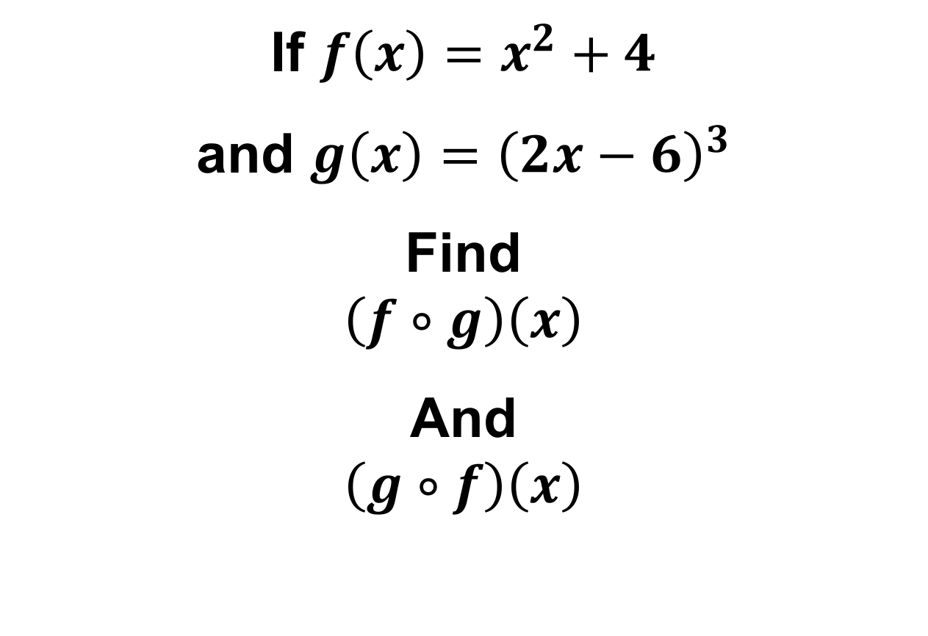
COMPOSITE FUNCTIONS
CODE: YELLOW
If $f\left(x\right)=x^{2}+4$
and $g\left(x\right)={\left(2x−6\right)}^{3}$
Find
$$\left(f∘g\right)\left(x\right)$$
And
$$\left(g∘f\right)\left(x\right)$$

Slide 6
COMPOSITE FUNCTIONS
CODE: BLUE
We can also decompose composite functions by breaking them into their parts.
$$\left(f∘g\right)\left(x\right)=f(g\left(x\right))$$
$$h\left(x\right)=\sqrt{x^{2}−3x+2}$$
can be written as the composition of…
$f\left(x\right)=$ $g\left(x\right)=$

Slide 7
COMPOSITE FUNCTIONS
CODE: BLUE
We can also decompose composite functions by breaking them into their parts.
$$\left(f∘g\right)\left(x\right)=f(g\left(x\right))$$
$$h\left(x\right)={\left(x^{3}+5\right)}^{4}$$
can be written as the composition of…
$f\left(x\right)=$ $g\left(x\right)=$

Slide 8
COMPOSITE FUNCTIONS
CODE: YELLOW
Determine whether the following functions are composite [f(g(x))].
If so, decompose them into f(x) and g(x).
h(x) = 7x² + 5x – 32
j(x) = cos(x)
k(x) = sin(x²)
l(x) = (x + 4)²
m(x) = x³ – 2x + 8
n(x) = cos³(x)

Slide 9
COMPOSITE FUNCTIONS
CODE: YELLOW
Determine whether the following functions are composite [f(g(x))].
If so, decompose them into f(x) and g(x).
h(x) = 7x² + 5x – 32
j(x) = cos(x)
k(x) = sin(x²)
l(x) = (x + 4)²
m(x) = x³ – 2x + 8
n(x) = cos³(x)

Slide 10
DOMAIN
CODE: BLUE
Recall that a function’s domain is the set of input values (or x values) feasible for the function.
The domain of a composite function must also consider the domains of its components.
$f(x) =\frac{3}{x−4}$ $g(x) =\frac{2}{x}$

Slide 11
DOMAIN
CODE: YELLOW
Recall that a function’s domain is the set of input values (or x values) feasible for the function.
The domain of a composite function must also consider the domains of its components.
$f(x) =\frac{2}{x−3}$ $g(x) =\sqrt{x}$

Slide 12
EXIT TICKET
CODE: RED
If $f\left(x\right)=5x−1$and $g\left(x\right)=x^{3}+1$, find each of the following and state the domain.
$(f+g)\left(x\right)$
$\left(\frac{f}{g}\right)\left(x\right)$
$\left(f∘g\right)\left(x\right)$
$\left(g∘f\right)\left(x\right)$

