Slide 1
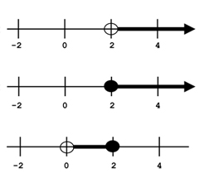
Bell ringer
CODE: GREEN
Write an inequality to represent each graph below. [Use x as the variable]
1.
2.
3.

Slide 2
FUNCTIONS
DOMAIN & RANGE

Slide 3
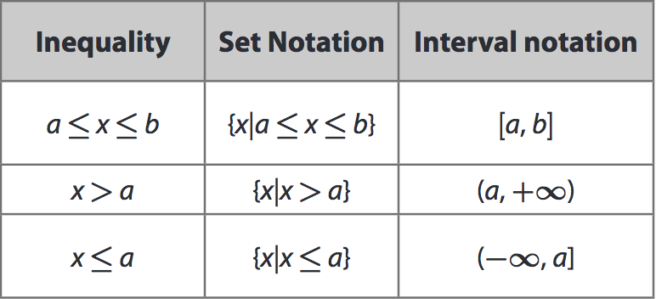
INTERVALS
CODE: BLUE
There are various ways to represent finite and infinite intervals.

Slide 4
INTERVALS
CODE: BLUE
There are various ways to represent finite and infinite intervals.

Slide 5
INTERVALS
CODE: BLUE
There are various ways to represent finite and infinite intervals.

Slide 6
INTERVALS
CODE: YELLOW

Slide 7
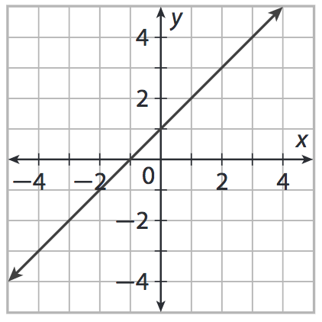
DOMAIN & RANGE
CODE: BLUE
The set of all input/independent values (typically the x values) is called the domain.
The set of all output/dependent values (typically the y values) is called the range.

Slide 8
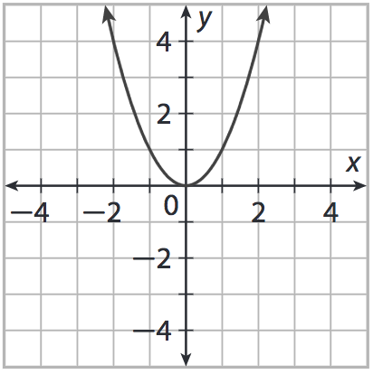
DOMAIN & RANGE
CODE: BLUE
The set of all input/independent values (typically the x values) is called the domain.
The set of all output/dependent values (typically the y values) is called the range.

Slide 9
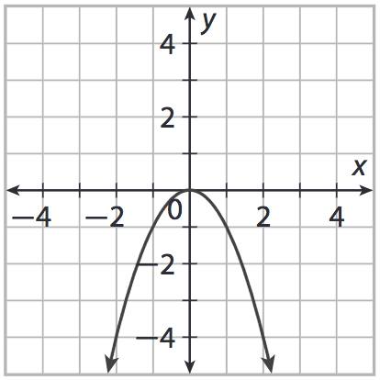
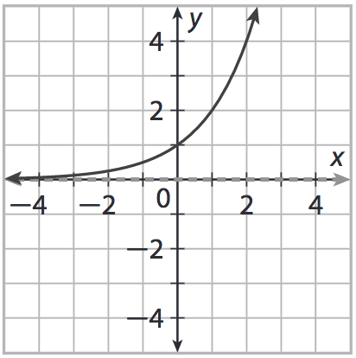
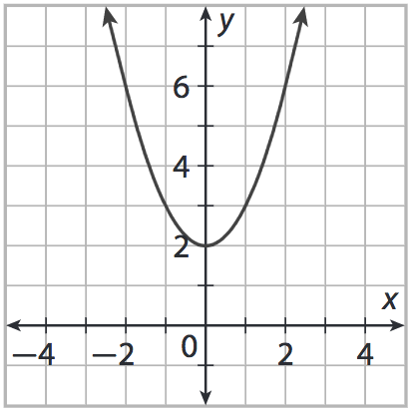
DOMAIN & RANGE
CODE: GREEN
State the domain and range of each graph below. You may use whichever representation makes the most sense to you.

Slide 10
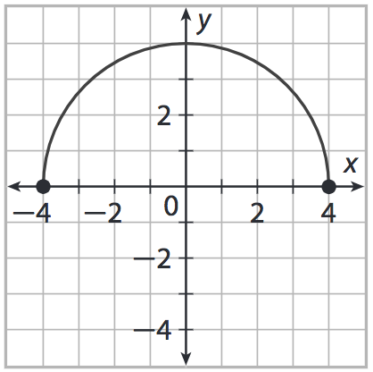
EXIT TICKET
CODE: RED
Veronica says that for the graph below, the domain is $0<x<4$ and the range is
$−4<y<4$. Is she correct? Explain why or why not. The write the correct domain and range in interval notation.

