Slide 1
Bell ringer
CODE: GREEN
Which part of the quadratic formula determines whether there will be real or complex solutions?
$$x=\frac{−b±\sqrt{b^{2}−4ac}}{2a}$$

Slide 2
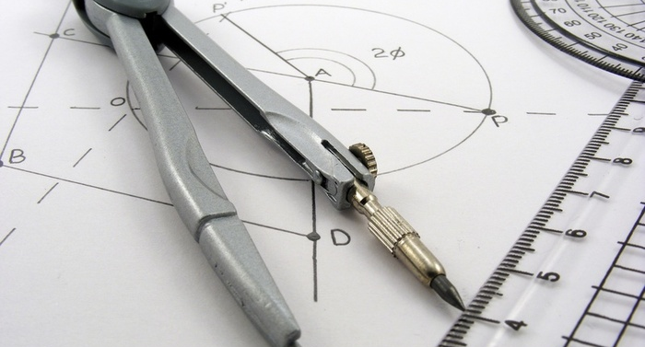
QUADRATIC FUNCTIONS
SYSTEMS OF EQUATIONS

Slide 3
SYSTEMS
CODE: BLUE
A system of equations involved two or more functions.
The solution to a system of equations represents the points where those functions intersect. A system can be solved by graphing, substitution or elimination.

Slide 4
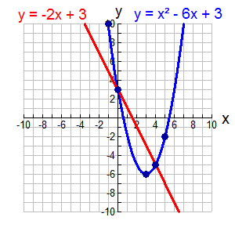
SYSTEMS
CODE: BLUE
Solve the following system graphically.

Slide 5
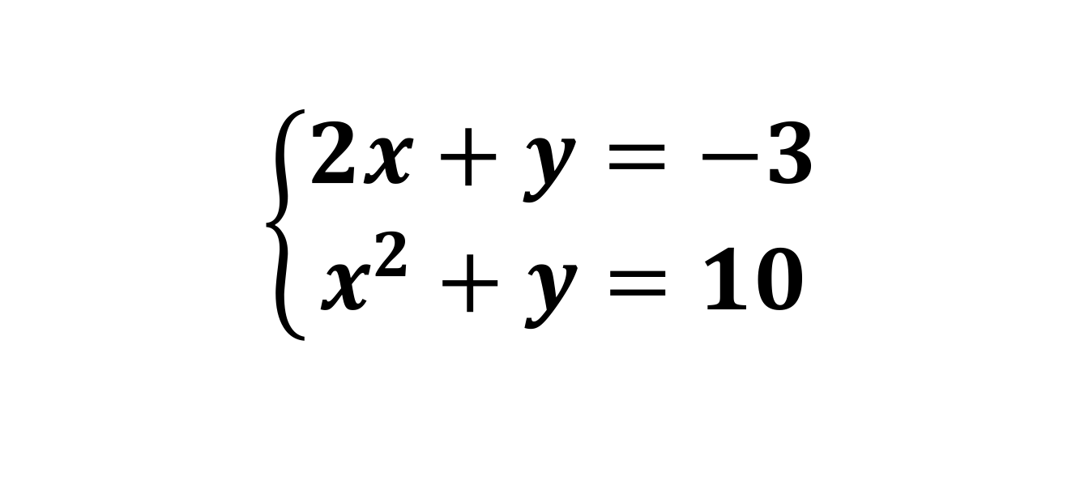
SYSTEMS
CODE: BLUE
Solve the following systems by substitution.
$$\left\{\begin{aligned}2x+y=−3 \\ x^{2}+y=10\end{aligned}\right.$$

Slide 6
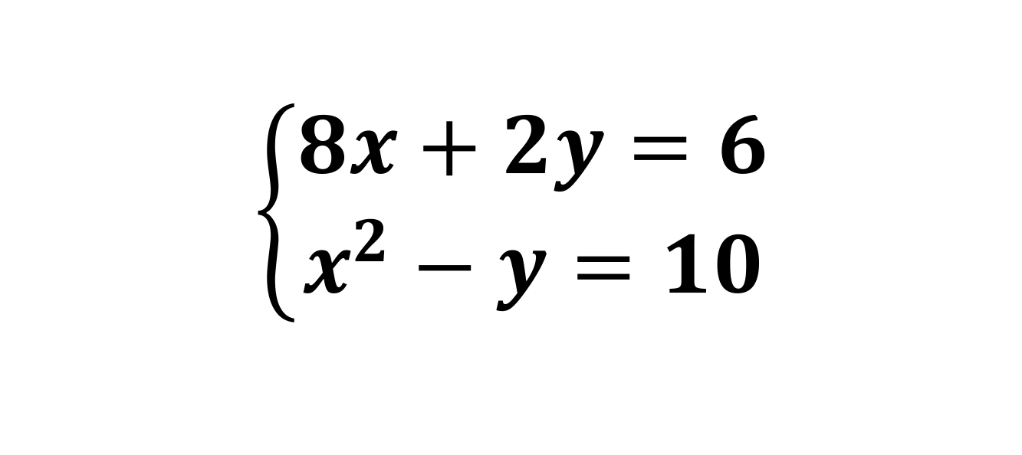
SYSTEMS
CODE: YELLOW
Solve the following systems by substitution.
$$\left\{\begin{aligned}8x+2y=6 \\ x^{2}−y=10\end{aligned}\right.$$

Slide 7
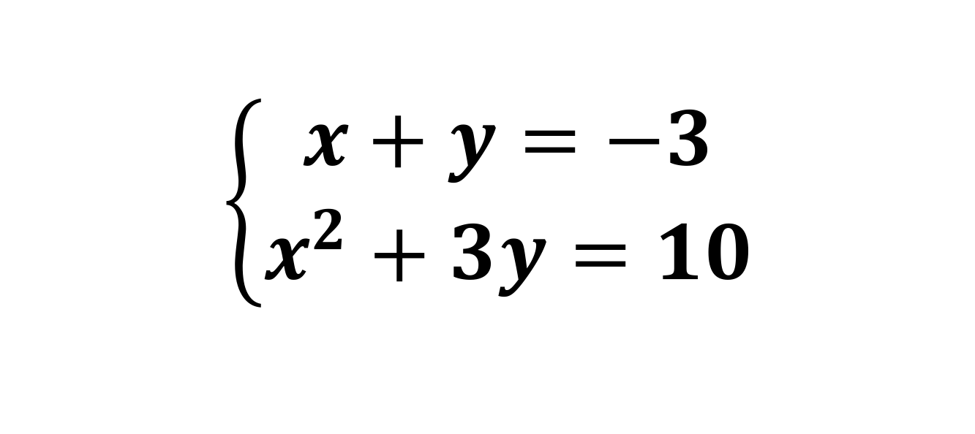
SYSTEMS
CODE: BLUE
Solve the following systems by elimination.
$$\left\{\begin{aligned}x+y=−3 \\ x^{2}+3y=10\end{aligned}\right.$$

Slide 8

SYSTEMS
CODE: YELLOW
Solve the following systems by elimination.
$$\left\{\begin{aligned}x+y=6 \\ x^{2}−2y=10\end{aligned}\right.$$

Slide 9
SYSTEMS
CODE: GREEN
Solve the following using elimination or substitution.
$\left\{\begin{aligned}x−y=7 \\ x^{2}−y=7\end{aligned}\right.$
$\left\{\begin{aligned}2x+y=6 \\ y−6=−x^{2}\end{aligned}\right.$

