Slide 1
Bell ringer
CODE: GREEN
What does inverse mean?
ie. To solve an equation, we must use the inverse operation.

Slide 2

FUNCTIONS
INVERSE FUNCTIONS

Slide 3
INVERSE FUNCTIONS
CODE: BLUE
An inverse function reverses the domain and range of a function.
f(x) = {(0,2), (-2,-3), (6,4), (5,-3)}

Slide 4
INVERSE FUNCTIONS
CODE: YELLOW
An inverse function reverses the domain and range of a function.
f(x) = {(3,7), (-12,2), (15,-1), (0,2)}

Slide 5
INVERSE FUNCTIONS
CODE: BLUE
An inverse function reverses the domain and range of a function.
f(x) = 3x + 4

Slide 6
INVERSE FUNCTIONS
CODE: YELLOW
An inverse function reverses the domain and range of a function.
f(x) = 2x – 2

Slide 7

INVERSE FUNCTIONS
CODE: BLUE
An inverse function reverses the domain and range of a function.
f(x) = $x^{2}−9$

Slide 8

INVERSE FUNCTIONS
CODE: YELLOW
Find the inverse and, if necessary, restrict its domain so that it is a function.
$$f(x)=\frac{\left(2x^{2}+6\right)}{3}$$

Slide 9

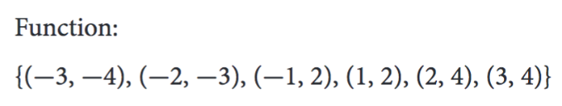

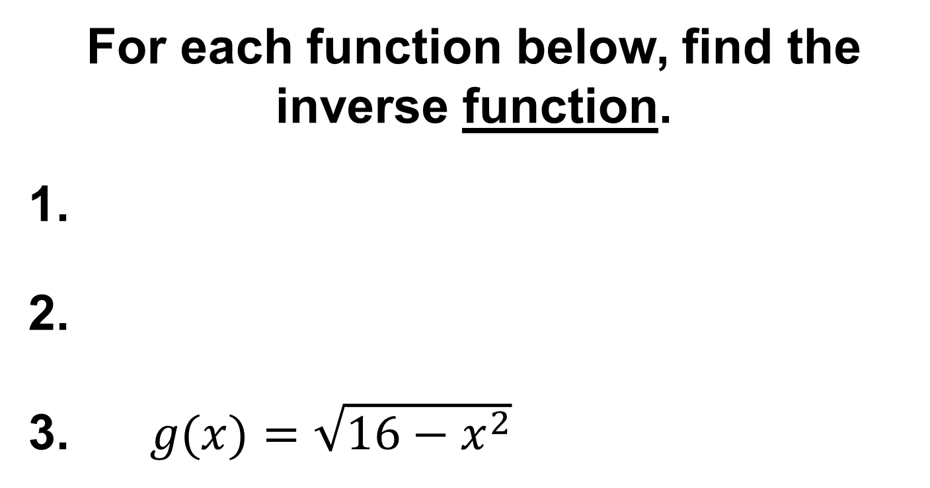
EXIT TICKET
CODE: RED
For each function below, find the inverse function.
$g(x)=\sqrt{16−x^{2}}$

