Slide 1
Bell ringer
CODE: GREEN
Grab a textbook and rip out pages 87-90 and 95.
Complete parts A and B of ‘Explore’ on page 87.

Slide 2
FUNCTIONS
ABSOLUTE VALUE INEQUALITIES

Slide 3
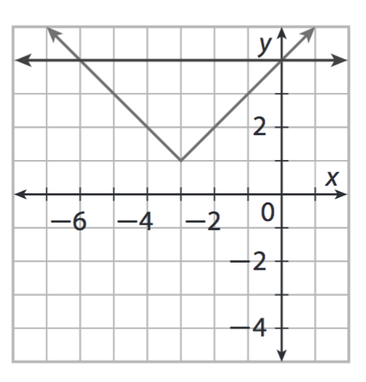
ABSOLUTE VALUE INEQUALITIES
CODE: BLUE
Absolutely value inequalities can be solved by graphing.

Slide 4
ABSOLUTE VALUE INEQUALITIES
CODE: YELLOW
Complete part B at the top of page 89.
If you finish answer questions 3 and 4.

Slide 5
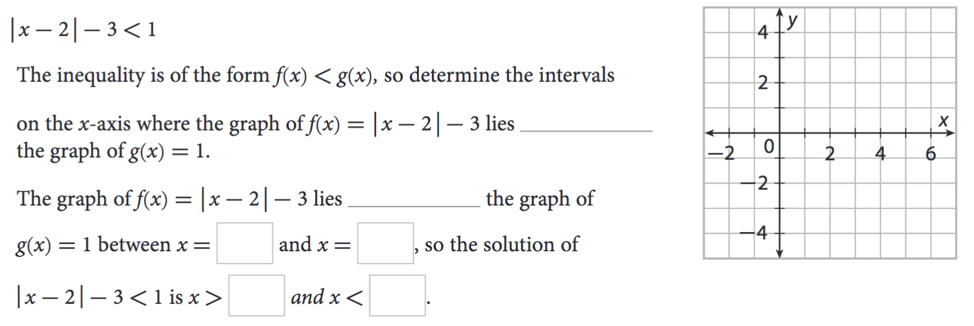
ABSOLUTE VALUE INEQUALITIES
CODE: BLUE

Slide 6
ABSOLUTE VALUE INEQUALITIES
CODE: BLUE
Absolutely value inequalities can also be solved algebraically.

Slide 7
ABSOLUTE VALUE INEQUALITIES
CODE: YELLOW
Complete part B on page 90.
If you finish, think about question 8.

Slide 8
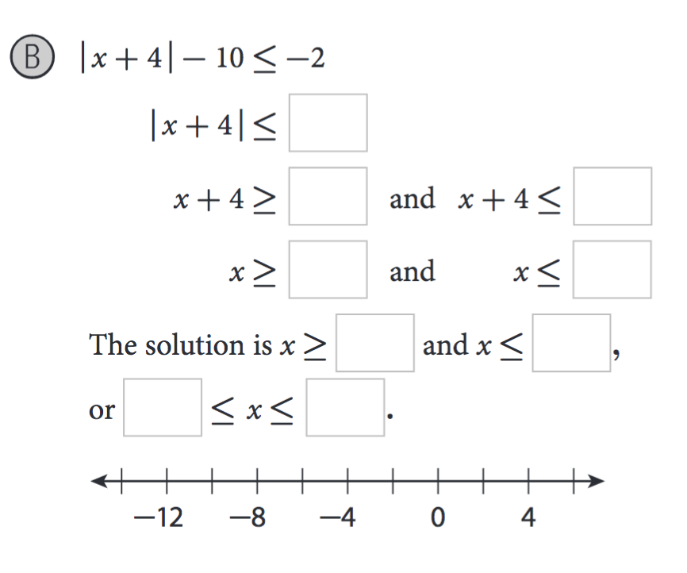
ABSOLUTE VALUE INEQUALITIES
CODE: BLUE

Slide 9
ABSOLUTE VALUE INEQUALITIES
CODE: GREEN
CLASSWORK
Complete #12, 13, and 14 on page 95.
If you finish early, you may complete #15 and 16 for extra credit.

Slide 10
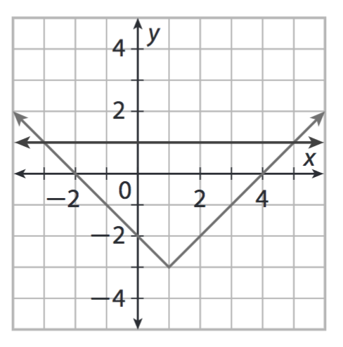
EXIT TICKET
CODE: RED

