Slide 1
Bell ringer
CODE: GREEN
What transformations are there in the equation below?
$$f\left(x\right)=2\left|x−5\right|−4$$
[When you finish your Bell Ringer,
grab a textbook and tear out pages 77-82]

Slide 2
FUNCTIONS
ABSOLUTE VALUE FUNCTIONS

Slide 3
transformations
CODE: YELLOW
Explore A
Using the transformations stated, graph the function f(x).
Then graph g(x)=2 [horizontal line]
If you finish, think about part B. What are the solutions?

Slide 4
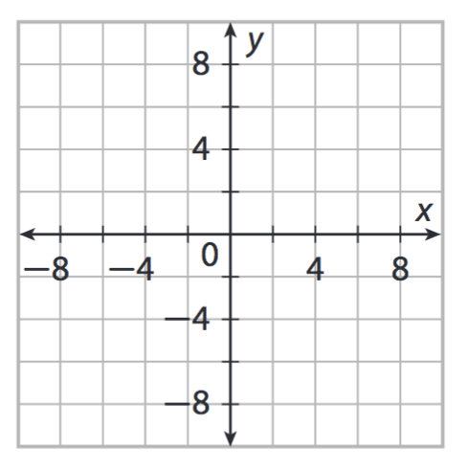

TRANSFORMATIONS
CODE: BLUE
$$f(x)=2|x−5|−4$$
$$g(x)=2$$

Slide 5

TRANSFORMATIONS
CODE: BLUE
$$\left|3x\right|+2=8$$

Slide 6

transformations
CODE: YELLOW
$$3\left|4x−5\right|−2=19$$

Slide 7

TRANSFORMATIONS
CODE: BLUE
$$−5\left|x+1\right|+2=12$$

Slide 8

transformations
CODE: YELLOW
$$\frac{3}{5}\left|2x−4\right|−3=−3$$

Slide 9
transformations
CODE: GREEN
Evaluate Practice [pg 81-82]
#1, 5, 7, 9, 13

Slide 10
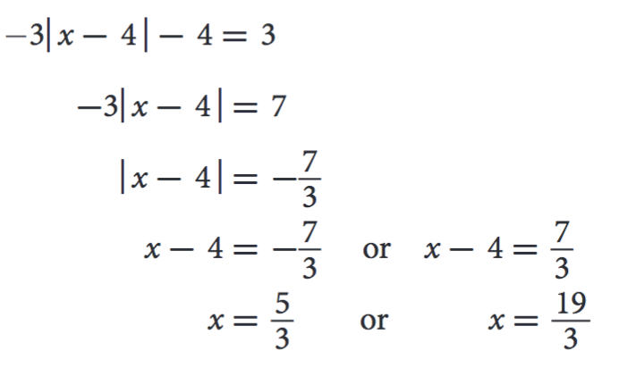
EXIT TICKET
CODE: RED
A student solved an equation using the steps below. Explain the error they made and find the correct solution.

