Slide 1
Bell ringer
CODE: GREEN
Rewrite each interval below in a different form.
1. $(−3,5]$
2. $x>−1$
3. All real numbers except 3

Slide 2
FUNCTIONS
DOMAIN & RANGE

Slide 3
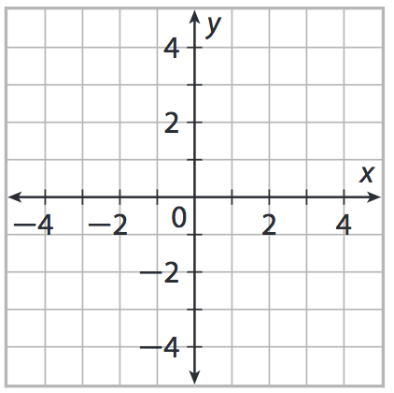
RESTRICTED DOMAIN
CODE: BLUE
Functions can be graphed with a restricted domain.

Slide 4
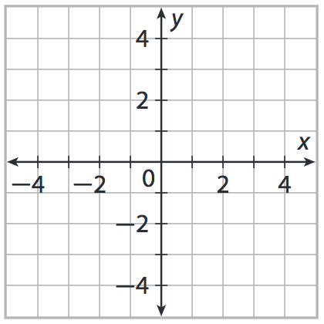
RESTRICTED DOMAIN
CODE: YELLOW

Slide 5
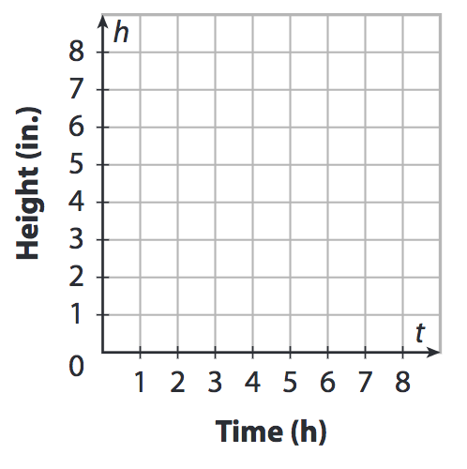
APPLICATION
CODE: BLUE
Domain and range can be important in the context of an applied function.

Slide 6
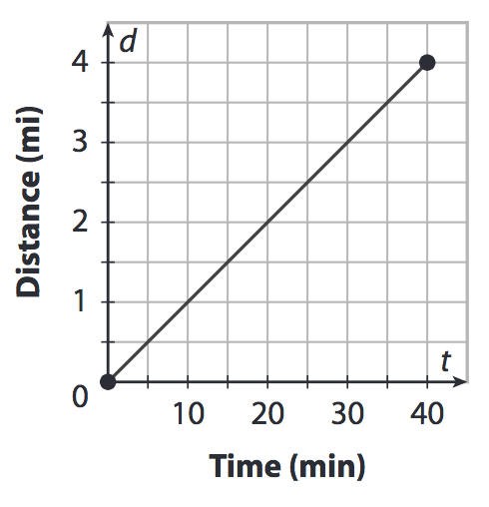
APPLICATION
CODE: YELLOW
State the domain and range of the graph below. If this graph represents Joyce’s jog, explain what the domain and range mean in the context of the situation.

Slide 7
DOMAIN & RANGE
CODE: GREEN
Find the endpoints for each of the restricted domains below and find the corresponding range.
State the domain and range of the situation described below.

Slide 8
EXIT TICKET
CODE: RED
Find the endpoint(s) and range of the restricted function.
Determine the domain and range of the situation described below.

